Slide 1
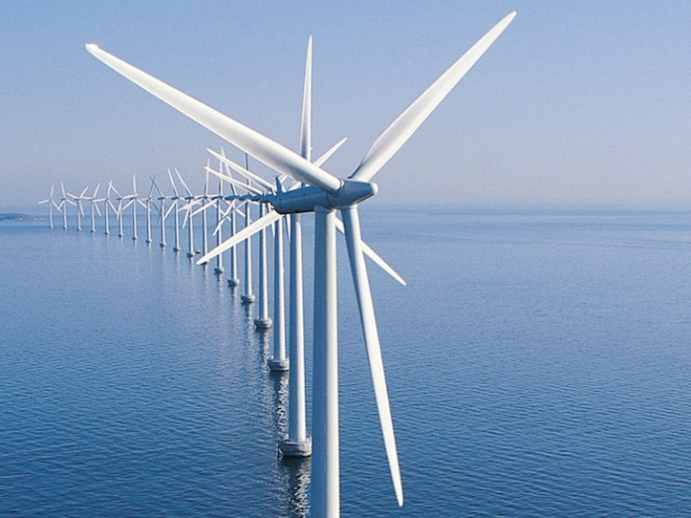
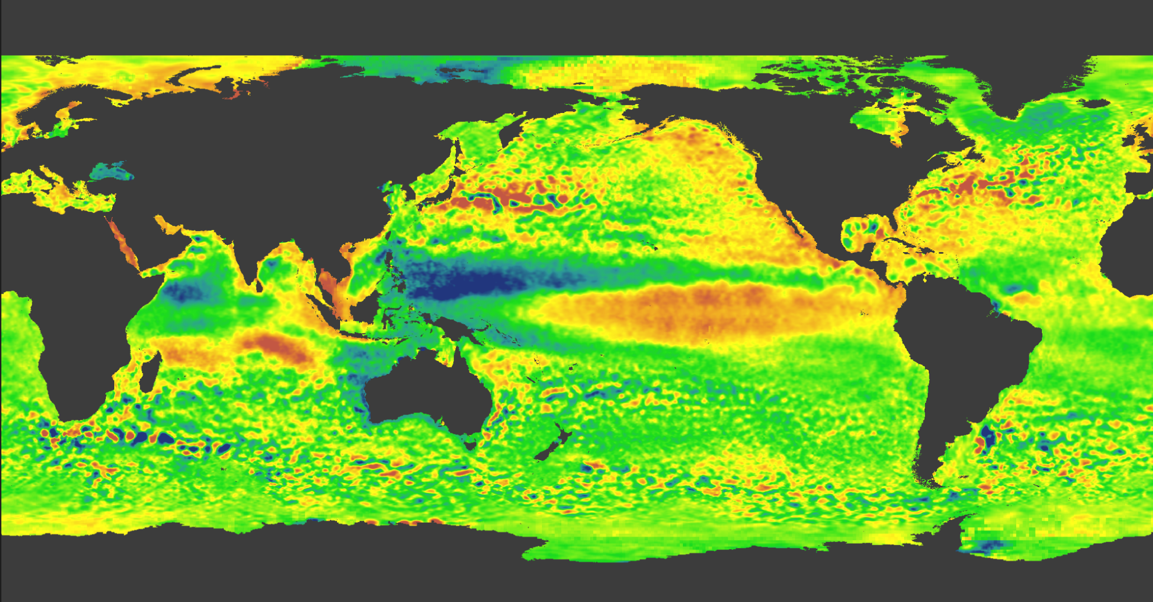
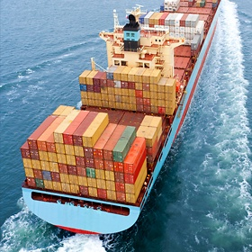
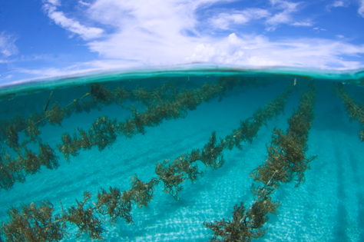
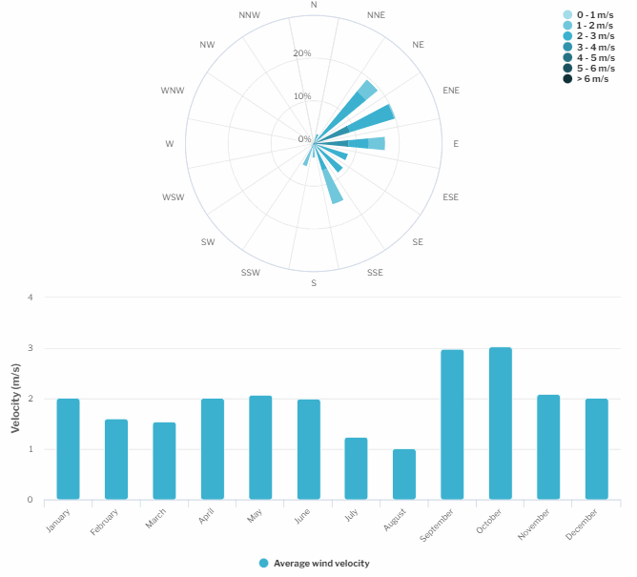
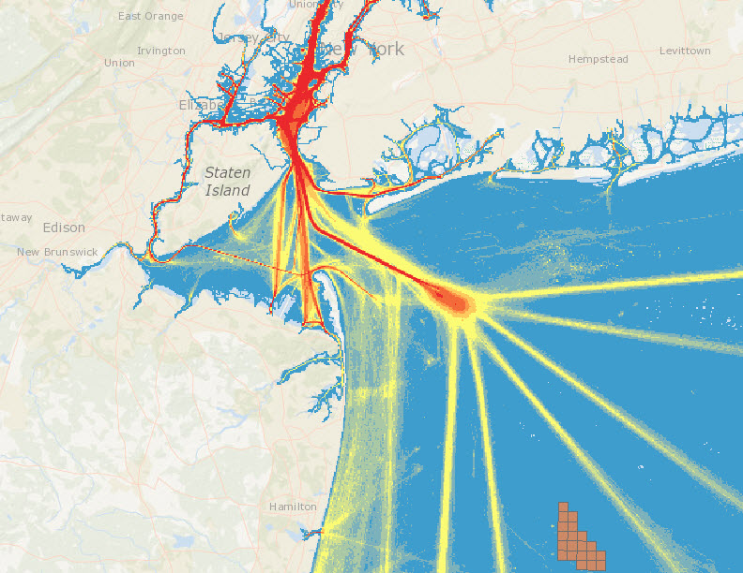



Gulf of Maine Cable Routing - Stellwagen Bank
NOAA OSW Spatial Team
James.Morris@noaa.gov

Slide 2
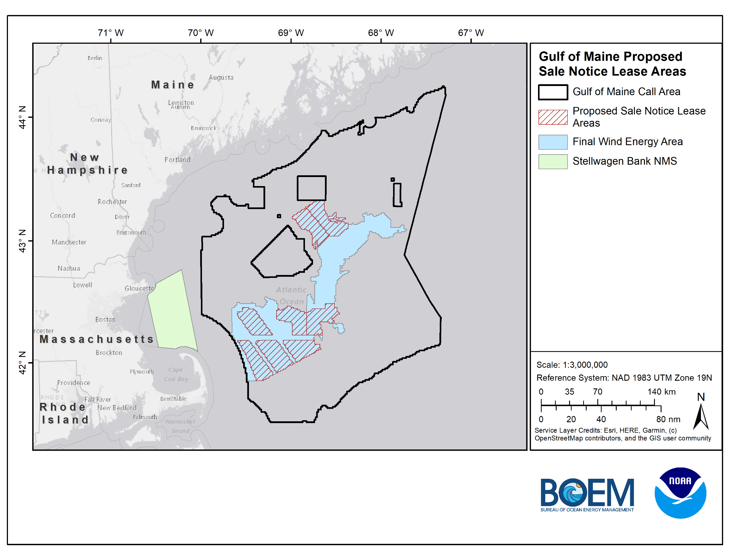
Proposed Sale Notice Lease Areas

Slide 3
Model Iterations
Model 2.1 - MA CZM Base Case
Model 2.2 - MA CZM Base Case (Cod Removed)
Model 2.3 - NMS Base Case
Model 2.4 - NMS Base Case (North of TSS)
Model 2.5 - NMS Base Case (South of TSS)
Notes:
So this data inventory will be developed and updated as outreach and engagement continues with stakeholders.

Slide 4
General Modeling Parameters
1,000-m wide corridors
50-m x 50-m square grid (consistent with MA CZM)
Points of Interconnection (End Points)
Boston
Plymouth
Data layers are scored 0 - 1 for inclusion in Least Cost Path Analysis; score closer to 0 is more suitable (lower cost), score closer to 1 is less suitable (higher cost)
Notes:
Roughly 0.01 ac resolution
So this data inventory will be developed and updated as outreach and engagement continues with stakeholders.

Slide 5
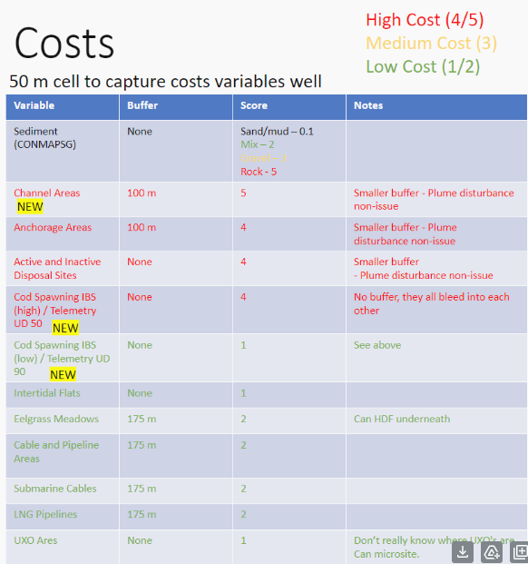
MA CZM Data/Scoring
NCCOS converted scores to fit 0 -1 scoring scale:
1 = 0.2
2 = 0.4
3 = 0.6
4 = 0.8
5 = 1
Notes:
So this data inventory will be developed and updated as outreach and engagement continues with stakeholders.

Slide 6
Model 2.1
MA CZM Base Case
Notes:
So this data inventory will be developed and updated as outreach and engagement continues with stakeholders.

Slide 7
Model 2.1 Data & Scoring
Data Sets | Score
Sediment (CONMAPSG) - Sand/Mud | 0.2
Sediment (CONMAPSG) - Mix | 0.4
Sediment (CONMAPSG) - Gravel | 0.6
Sediment (CONMAPSG) - Rock | 1
Cod Spawning IBS (High)/Telemetry (UD 50) | 0.8
Cod Spawning IBS (Low)/Telemetry (UD 90) | 0.2
Active and Inactive Disposal Sites - (500-m setback) | 0.8
Intertidal Flats - (500-m setback) | 0.2
Sand Patches - (500-m setback) | 1
Channel Areas - (600-m setback) | 1
Anchorage Areas - (600-m setback) | 0.8
Eelgrass Meadows - (675-m setback) | 0.4
Cable and Pipeline Areas - (675-m setback) | 0.4
Submarine Cables - (675-m setback) | 0.4
LNG Pipelines - (675-m setback) | 0.4
*Note recommended setback distances include an additional 500-m to account for a 1-km cable corridor, LCP analysis identifies a line, which is then given a 500-m setback
Notes:
So this data inventory will be developed and updated as outreach and engagement continues with stakeholders.

Slide 8
Model 2.1 Data & Scoring - Barriers
Barrier Data Sets | Score
Coral Points (MA CZM provided) - (675-m setback) | 0
Sites to Avoid (NMS provided) - (1000-m setback) | 0
Boulder Ridges (NMS provided) - (500-m setback) | 0
Cape 500-m setback from shore | 0
Notes:
So this data inventory will be developed and updated as outreach and engagement continues with stakeholders.

Slide 9
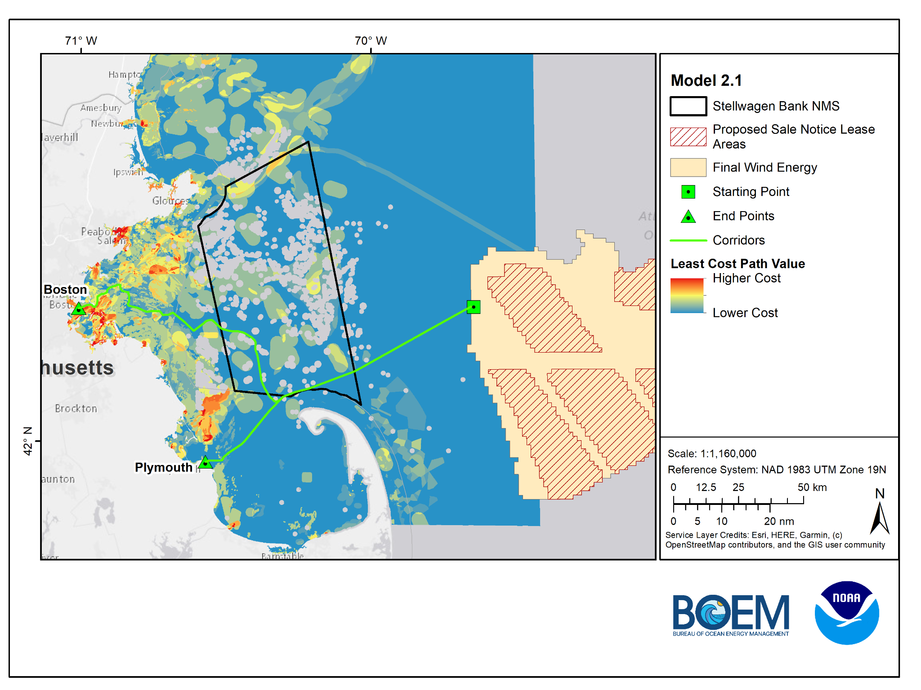
Model 2.1
MA CZM
Base Case
*Cod spawning areas are primarily driving the model
Boston Route = 101.5 miles
Plymouth Route = 66 miles

Slide 10
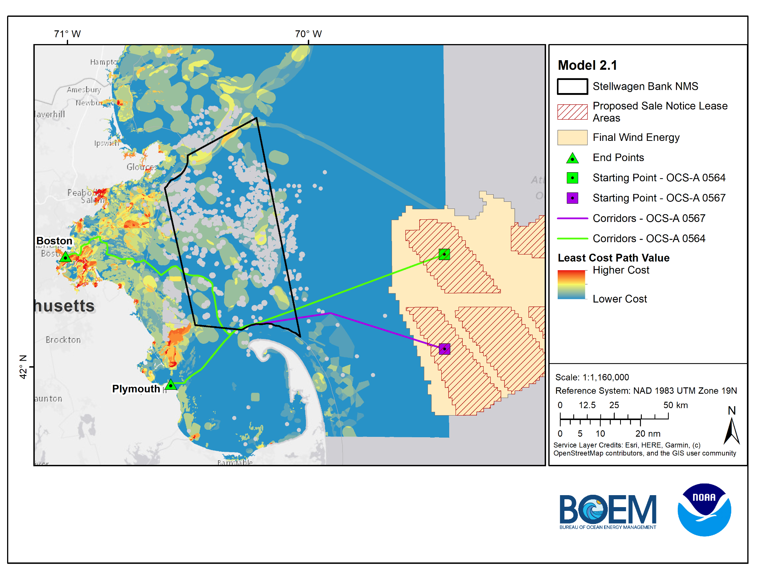
Model 2.1
MA CZM
Base Case
*Cod spawning areas are primarily driving the model
OCS-A 0564 Lease
Boston Route = 101.5 miles
Plymouth Route = 66 miles
OCS-A 0567 Lease
Boston Route = 100 miles
Plymouth Route = 64.9 miles

Slide 11
Model 2.2
MA CZM Base Case (Cod Removed)
Notes:
So this data inventory will be developed and updated as outreach and engagement continues with stakeholders.

Slide 12
Model 2.2 Data & Scoring
Data Sets | Score
Sediment (CONMAPSG) - Sand/Mud | 0.02
Sediment (CONMAPSG) - Mix | 0.4
Sediment (CONMAPSG) - Gravel | 0.6
Sediment (CONMAPSG) - Rock | 1
Cod Spawning IBS (High)/Telemetry (UD 50) | 0.8
Cod Spawning IBS (Low)/Telemetry (UD 90) | 0.2
Active and Inactive Disposal Sites - (500-m setback) | 0.8
Intertidal Flats - (500-m setback) | 0.2
Sand Patches - (500-m setback) | 1
Channel Areas - (600-m setback) | 1
Anchorage Areas - (600-m setback) | 0.8
Eelgrass Meadows - (675-m setback) | 0.4
Cable and Pipeline Areas - (675-m setback) | 0.4
Submarine Cables - (675-m setback) | 0.4
LNG Pipelines - (675-m setback) | 0.4
*Note recommended setback distances include an additional 500-m to account for a 1-km cable corridor, LCP analysis identifies a line, which is then given a 500-m setback
Notes:
So this data inventory will be developed and updated as outreach and engagement continues with stakeholders.

Slide 13
Model 2.2 Data & Scoring - Barriers
Barrier Data Sets | Score
Coral Points (MA CZM provided) - (675-m setback) | 0
Sites to Avoid (NMS provided) - (1000-m setback) | 0
Boulder Ridges (NMS provided) - (500-m setback) | 0
Cape 500-m setback from shore | 0
Notes:
So this data inventory will be developed and updated as outreach and engagement continues with stakeholders.

Slide 14
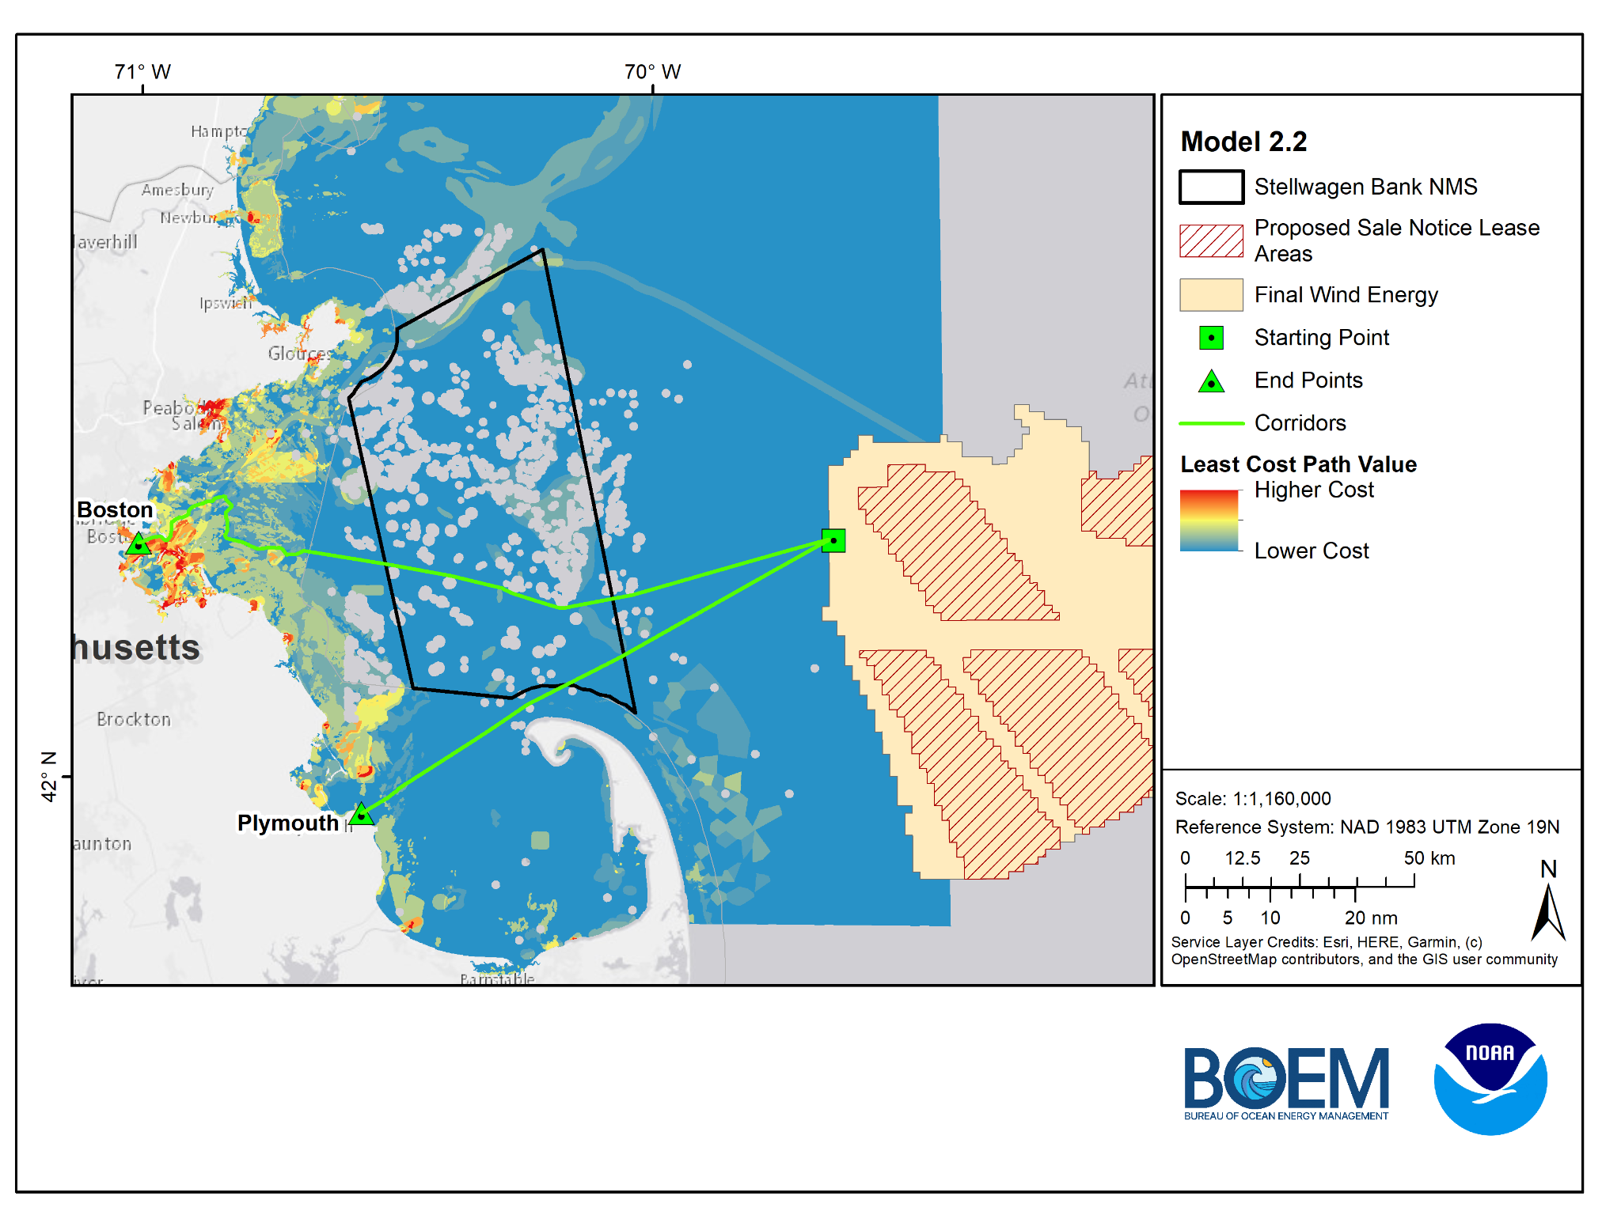
Model 2.2
MA CZM
Base Case
Removed Cod Spawning Areas

Slide 15
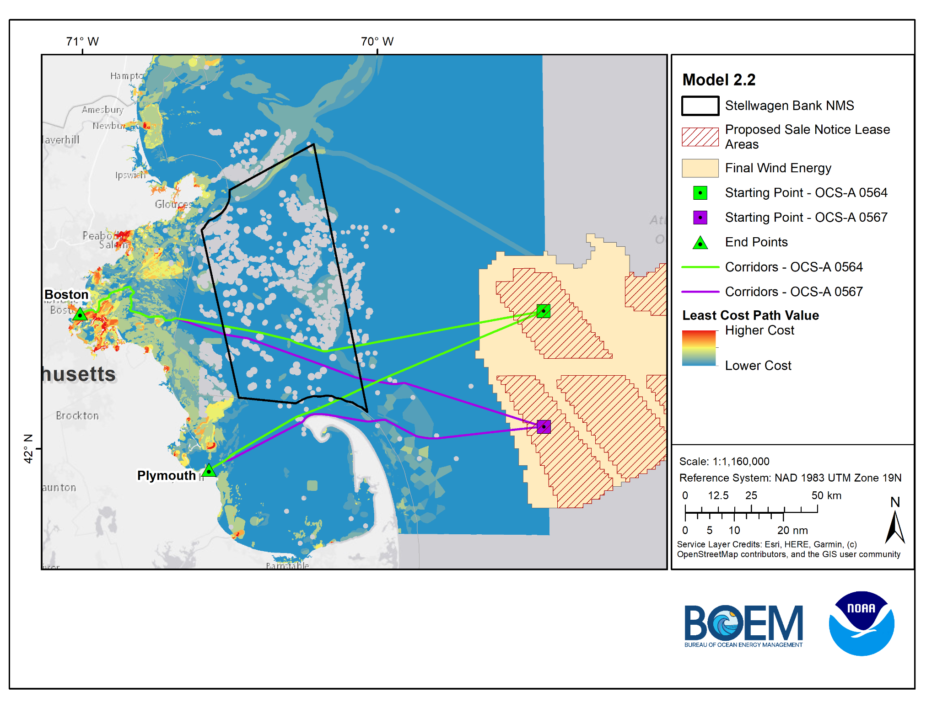
Model 2.2
MA CZM
Base Case
Removed Cod Spawning Areas
OCS-A 0564 Lease
Boston Route = 90.1 miles
Plymouth Route = 64.6 miles
OCS-A 0567 Lease
Boston Route = 92 miles
Plymouth Route = 62 miles

Slide 16
Model 2.3
NMS Base Case
Notes:
So this data inventory will be developed and updated as outreach and engagement continues with stakeholders.

Slide 17
Model 2.3 Data & Scoring
Model 2.3 Barriers
Data Sets | Score
NMS Sediment - Gravel | 0.5
Submarine Cables - (675-m setback) | 0.5
Slope (Flatter is better) | Increasing Linear
Barrier Data Sets | Score
Sites to Avoid (NMS provided) - (1000-m setback) | 0
Boulder Ridges (NMS provided) - (500-m setback) | 0
*Note recommended setback distances include an additional 500-m to account for a 1-km cable corridor, LCP analysis identifies a line, which is then given a 500-m setback
Notes:
So this data inventory will be developed and updated as outreach and engagement continues with stakeholders.

Slide 18
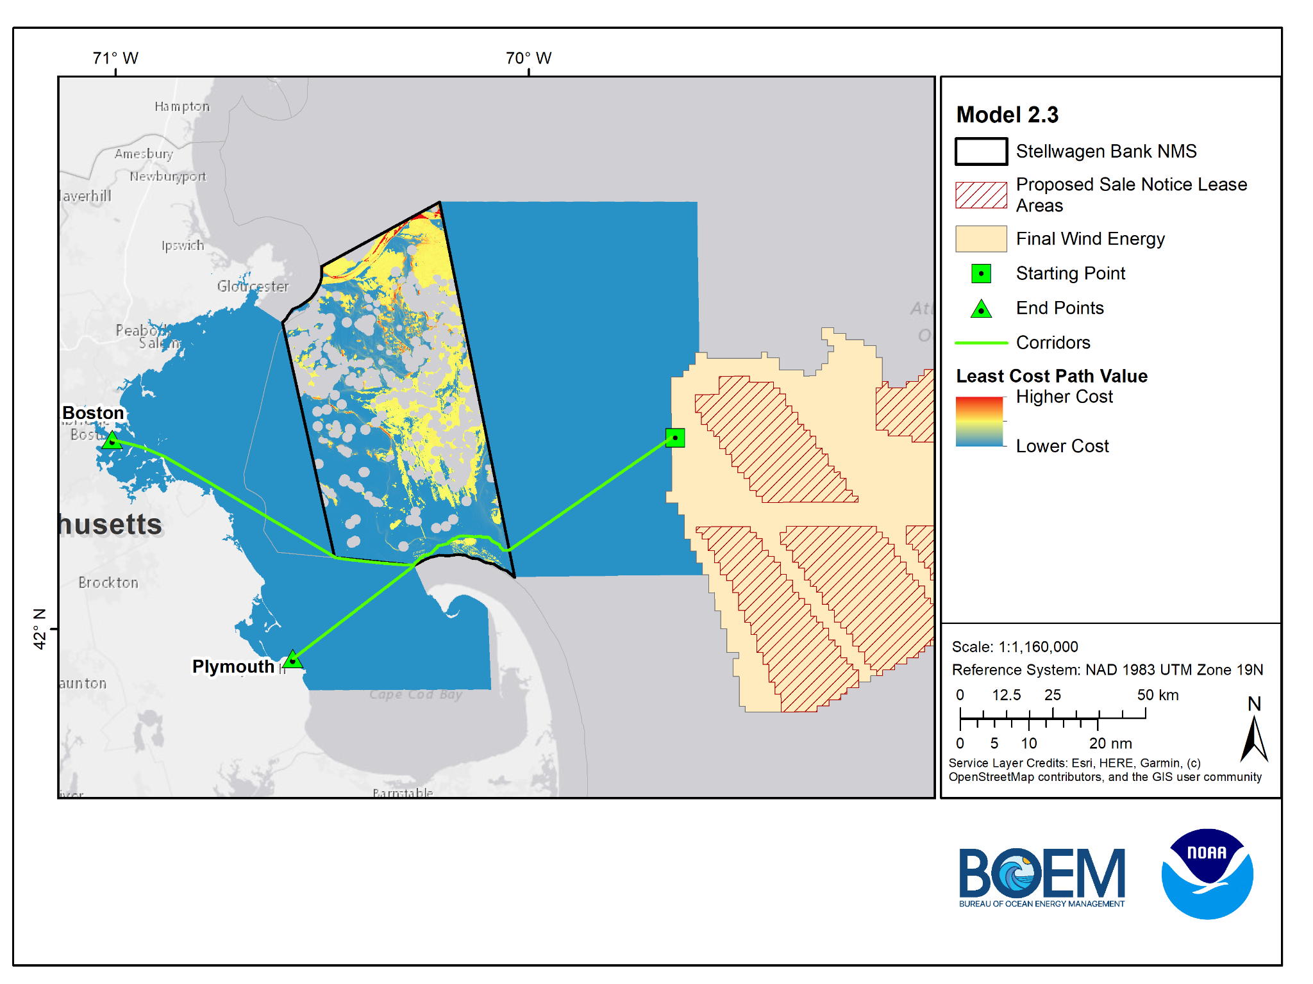
Model 2.3
NMS Base Case

Slide 19
Model 2.4
NMS Base Case (North of TSS)
Notes:
So this data inventory will be developed and updated as outreach and engagement continues with stakeholders.

Slide 20
Model 2.4 Data & Scoring
Model 2.4 Barriers
Data Sets | Score
NMS Sediment - Gravel | 0.5
Submarine Cables - (675-m setback) | 0.5
Slope (Flatter is better) | Increasing Linear
Barrier Data Sets | Score
Sites to Avoid (NMS provided) - (1000-m setback) | 0
Boulder Ridges (NMS provided) - (500-m setback) | 0
*Note recommended setback distances include an additional 500-m to account for a 1-km cable corridor, LCP analysis identifies a line, which is then given a 500-m setback
Notes:
So this data inventory will be developed and updated as outreach and engagement continues with stakeholders.

Slide 21
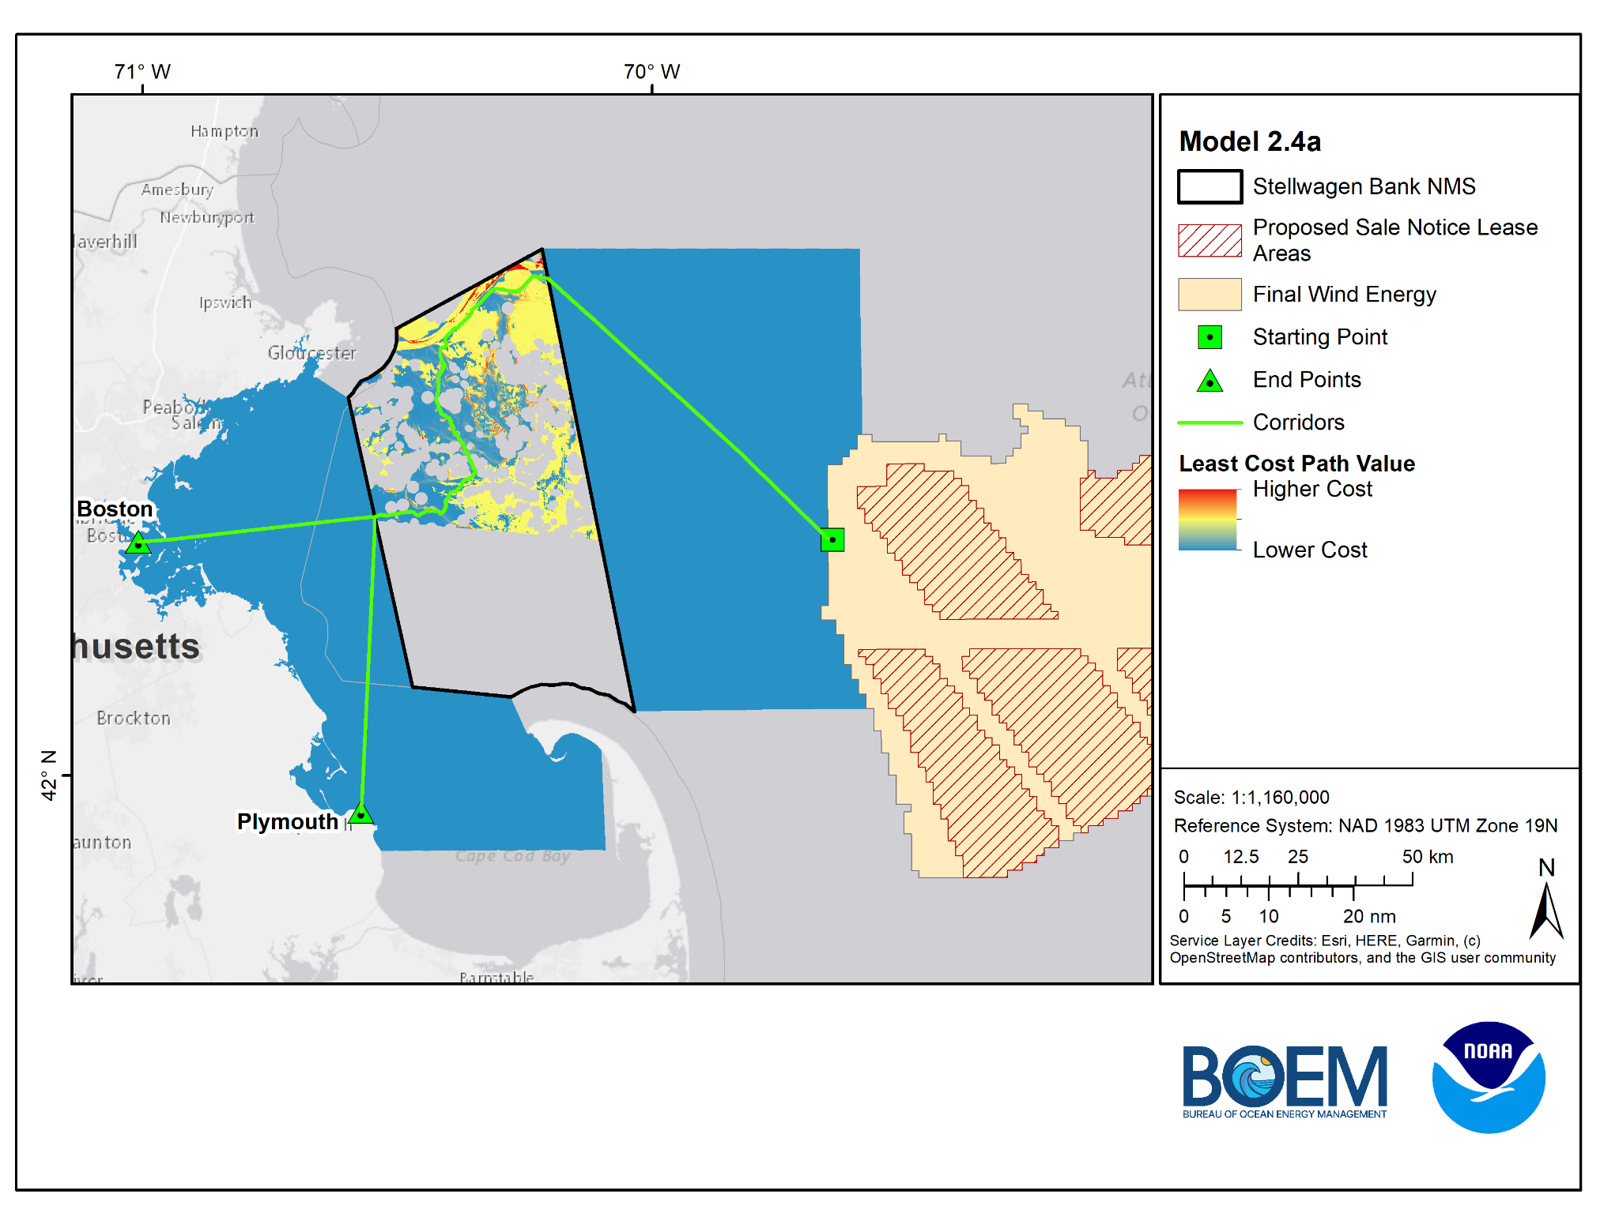
Model 2.4a
NMS Base Case
North of TSS

Slide 22

Model 2.4b
NMS Base Case
North of TSS
Exit northern portion of NMS

Slide 23
Model 2.5
NMS Base Case (South of TSS)
Notes:
So this data inventory will be developed and updated as outreach and engagement continues with stakeholders.

Slide 24
Model 2.5 Data & Scoring
Model 2.5 Barriers
Data Sets | Score
NMS Sediment - Gravel | 0.5
Submarine Cables - (675-m setback) | 0.5
Slope (Flatter is better) | Increasing Linear
Barrier Data Sets | Score
Sites to Avoid (NMS provided) - (1000-m setback) | 0
Boulder Ridges (NMS provided) - (500-m setback) | 0
*Note recommended setback distances include an additional 500-m to account for a 1-km cable corridor, LCP analysis identifies a line, which is then given a 500-m setback
Notes:
So this data inventory will be developed and updated as outreach and engagement continues with stakeholders.

Slide 25
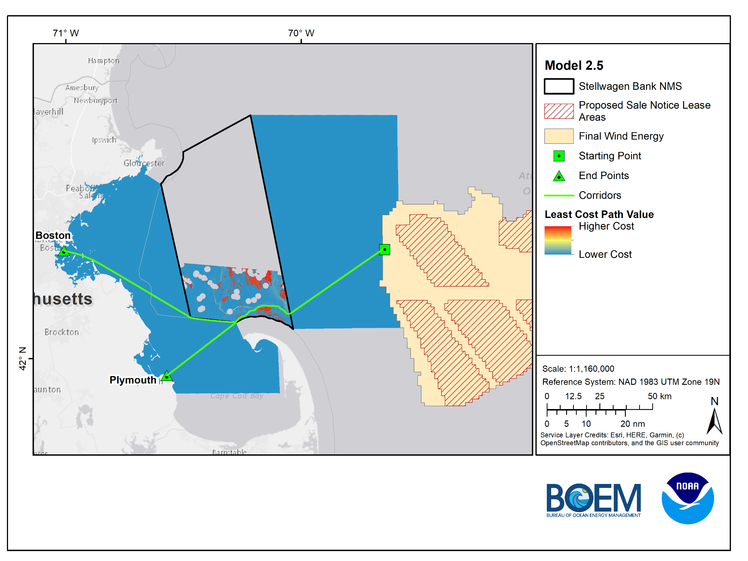
Model 2.5
NMS Base Case
South of TSS

Slide 26
Model Comparison
Model 2.1 - MA CZM Base Case
Model 2.2 - Base Case No Cod
Model 2.3 - NMS Base Case
Model 2.4a - North of TSS
Model 2.4b - North of TSS
Model 2.5 - South of TSS

